Slide 1
Polycystic Ovarian Syndrome,
Diabetes and Insulin Resistance,
Obesity
Are they related?
Metabolic Syndrome
Ara Keshishian, MD, FACS, FASMBS
Yerevan 2022

Slide 2
Instructions:
Objective
Define:
Obesity, Causes
Polycystic Ovarian Syndrome
Type II diabetes and Insulin Resistance
Metabolic Syndrome
Changing Paradigm:
Diagnostic criteria
Treatment options
Follow the Science
All interconnected conditions
2

Slide 3
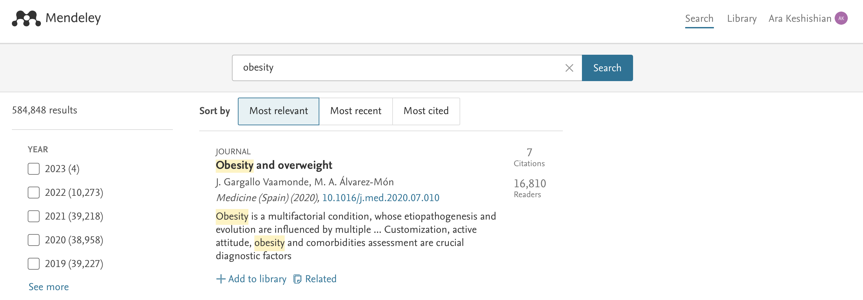
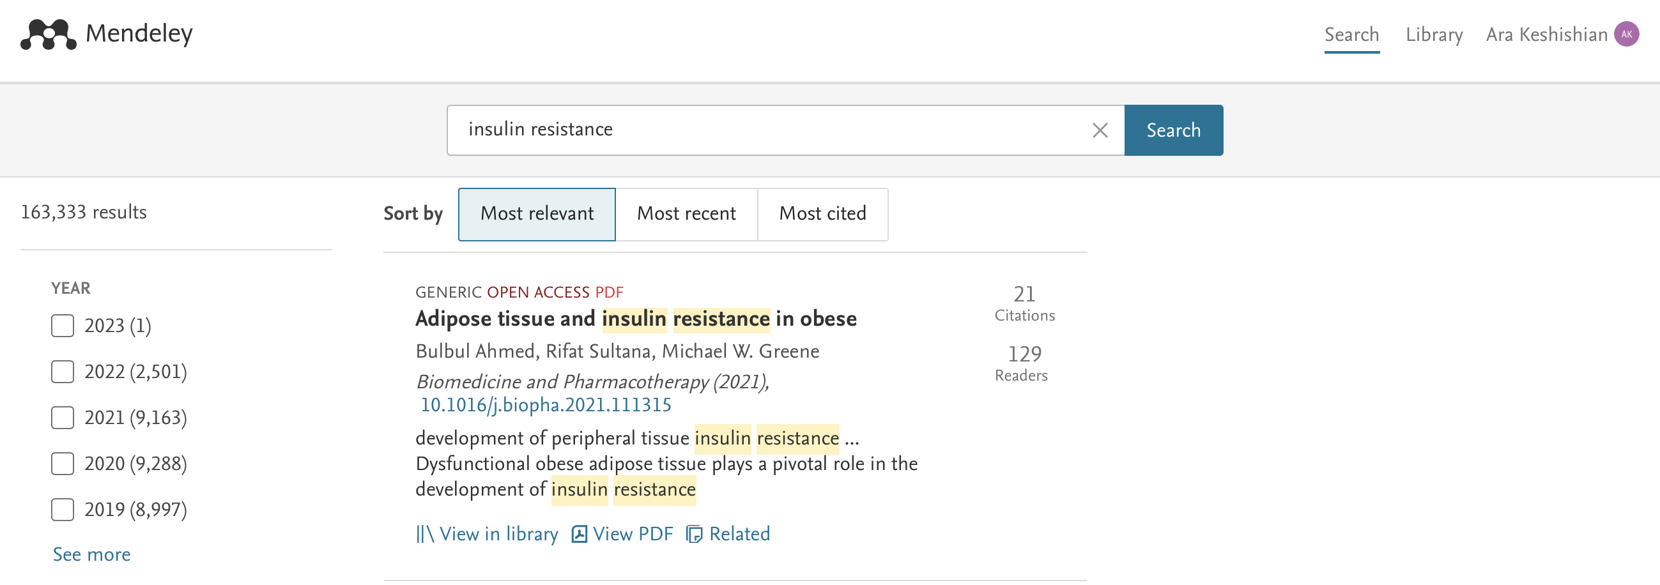
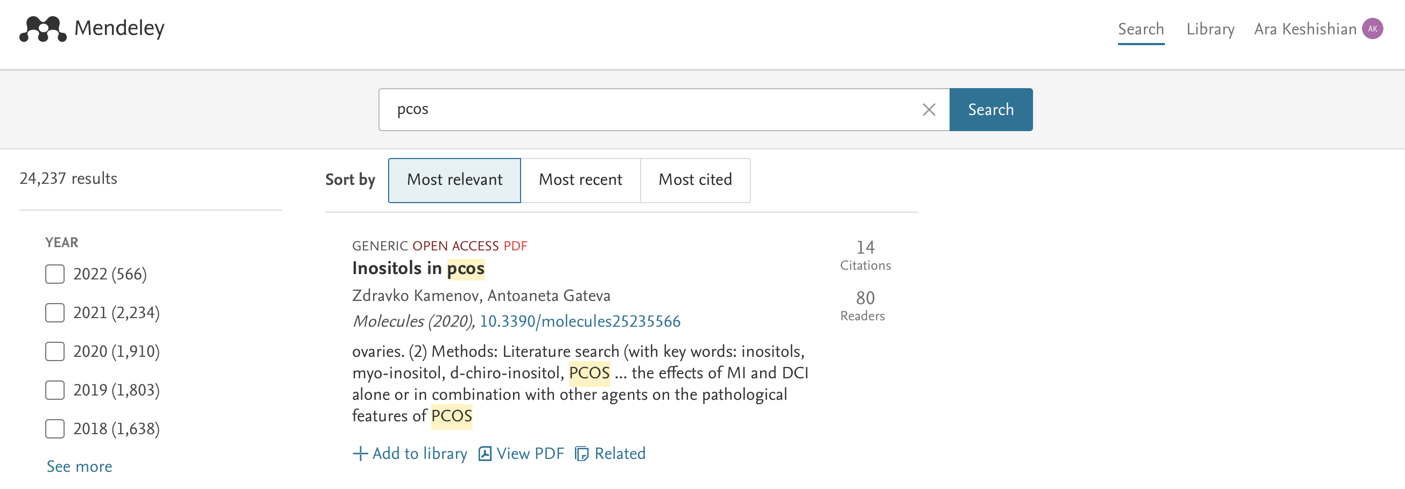
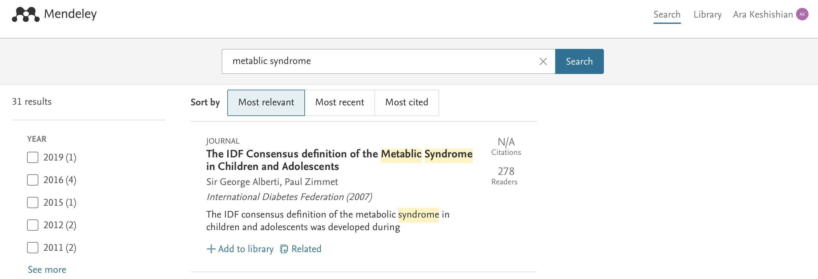
Instructions:
Evolving Knowledge Base
3

Slide 4
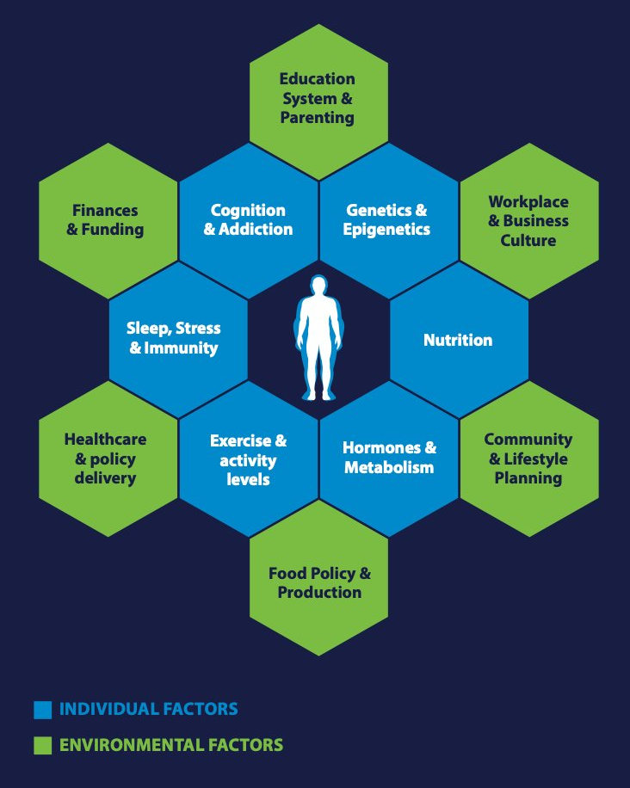
Instructions:
Causes of Obesity
Multifactorial:
Genetics
Hormones
Lifestyle
Root Causes
Not as obvious to clinicians
Sliding scale
BMI >45, 1980’s
BMI >30, 2022
4

Slide 5
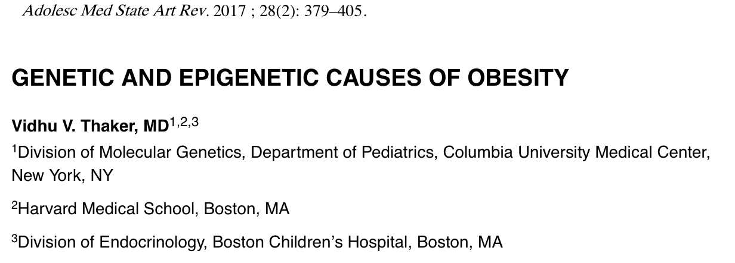
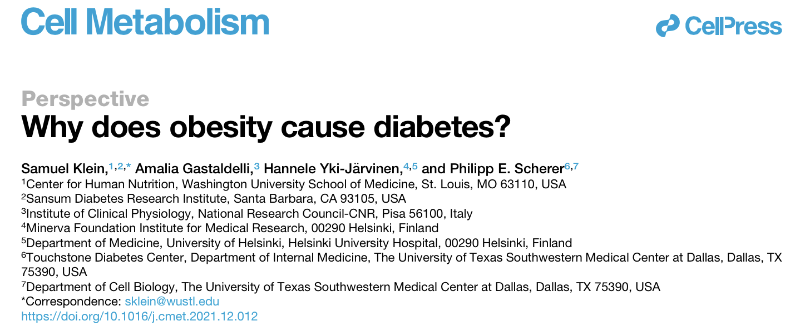
Instructions:
Causes of Obesity
Multifactorial:
Genetics
Hormones
Lifestyle
5
(Hanssen et al., 2022; Klein et al., 2022; Thaker, 2021)

Slide 6
Instructions:
Causes of Obesity
There is a point of no return -Diet.
5kg yes
10 kg maybe
25 kg no
6
(Hanssen et al., 2022; Klein et al., 2022; Thaker, 2021)

Slide 7
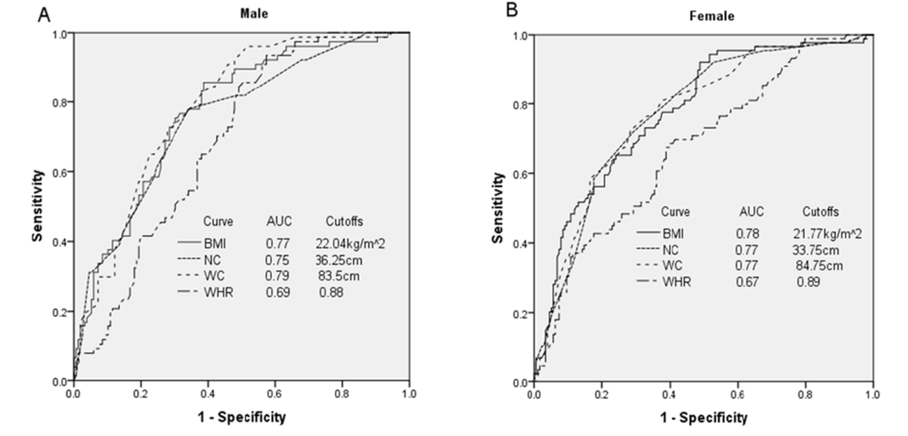
Instructions:
Obesity and Insulin Resistance
There is a point of no return -Diet.
5kg yes
10 kg maybe
25 kg no
7
(Hanssen et al., 2022; Klein et al., 2022; Thaker, 2021)
(Jiang et al., 2020)

Slide 8
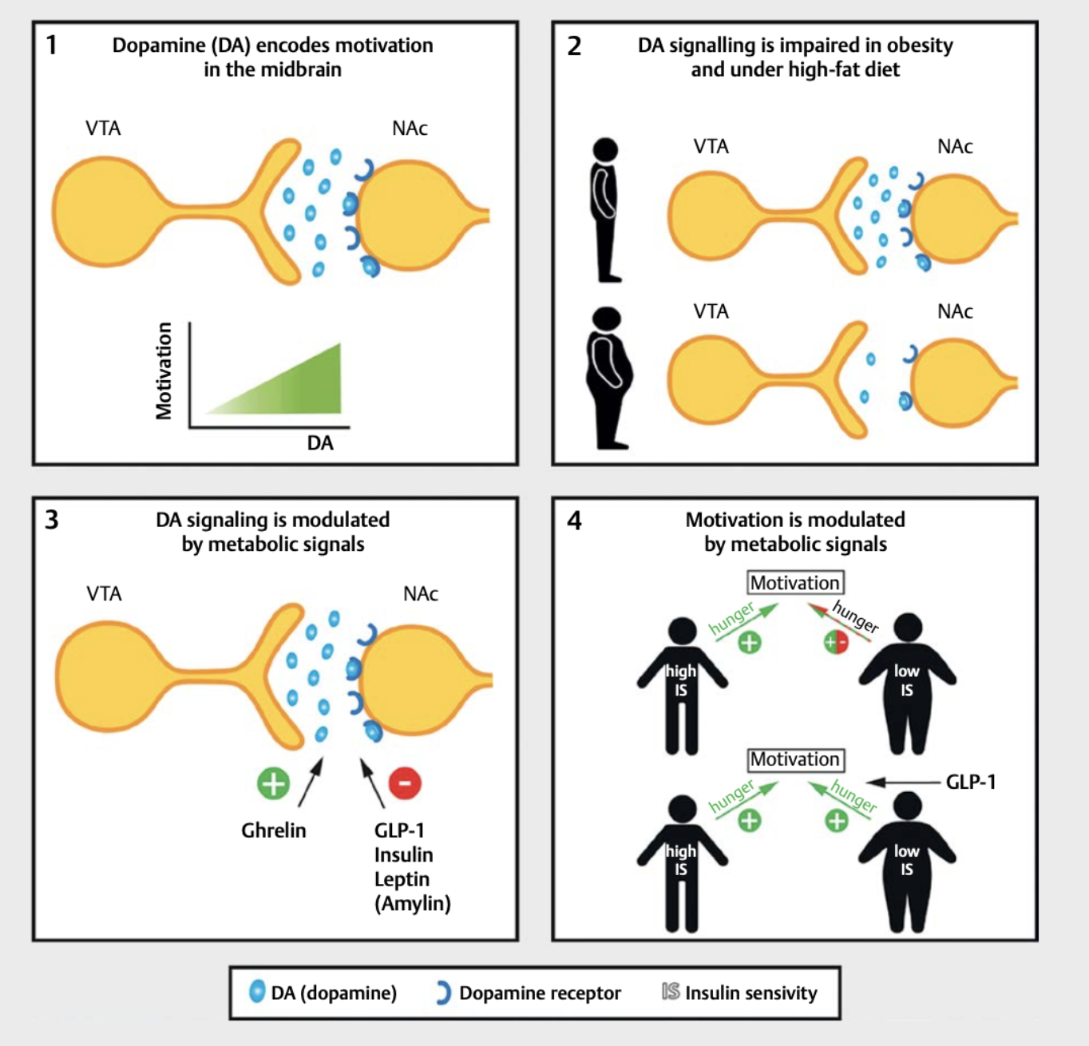
Instructions:
Causes of Obesity
1) Dopamine (DA) encodes motivation in the midbrain; dopaminergic neu­rons project from the ventral tegmental area (VTA) to the nucleus accumbens (NAc) with higher dopaminergic tone encoding higher motivation.
2) Dopamine signaling is impaired in obesity and under high ­fat diet. The binding potential of dopaminergic D2 receptors is reduced in obesity and high ­fat diet causing a reduced dopamine release from the VTA upon receival of standard food and thus diminishing the reward­ing properties of food discovery.
3) Ghrelin applied into the VTA increases dopamine levels in the NAc and hence motivation; glucagon ­like peptide 1 (GLP­1), insulin, leptin and (probably) amylin reduce motivated behavior for food rewards in mice by downregulating dopaminergic transmission.
4) In humans, motivation increases with increasing hunger levels in normal weight humans with good insulin sensitivity, while in obese humans with reduced insulin sensitivity hunger does not affect motivation. Intervention with GLP-1 does not affect motivation in insulin sensitive humans but normalizes the effect of hunger on motivation in insulin resistant humans.
8
(Hanssen et al., 2022)

Slide 9
Instructions:
GLP-1 Agonists
Dulaglutide (Trulicity) (weekly)
Exenatide extended release (Bydureon bcise) (weekly)
Exenatide (Byetta) (twice daily)
Semaglutide (Ozempic) (weekly)
Liraglutide (Victoza, Saxenda) (daily)
Lixisenatide (Adlyxin) (daily)
Semaglutide (Rybelsus) (taken by mouth once daily)
9
(Hanssen et al., 2022)

Slide 10
Instructions:
Polycystic Ovarian Syndrome
PCOS : 6-20% → 50% female pre-menopause if obese
Clinical manifestation of hyperandrogenism
The physical manifestations are all interrelated
Insulin resistance
Hyperinsulinemia
Hirsutism
Acanthosis Nigricans
Infertility, irregular menses
Interesting
“Ultrasound does not show cysts.”
30% may have multiple cysts
10
(Dunaif, 1997; Marshall & Dunaif, 2012)

Slide 11
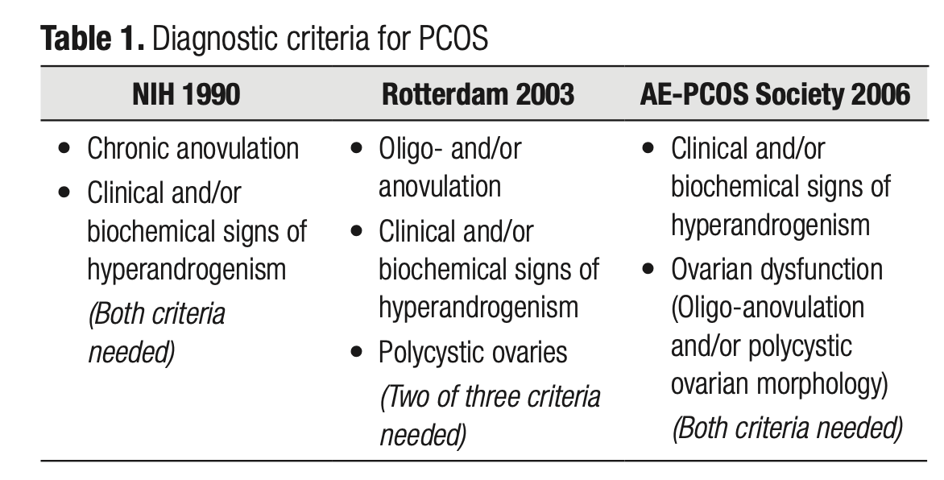
Instructions:
Polycystic Ovarian Syndrome
How is it diagnosed:
1990’s → 2000’s → 2010 “Ultrasound does not show cysts.”
(Crespo et al., 2018)
https://ae-society.org
11

Slide 12
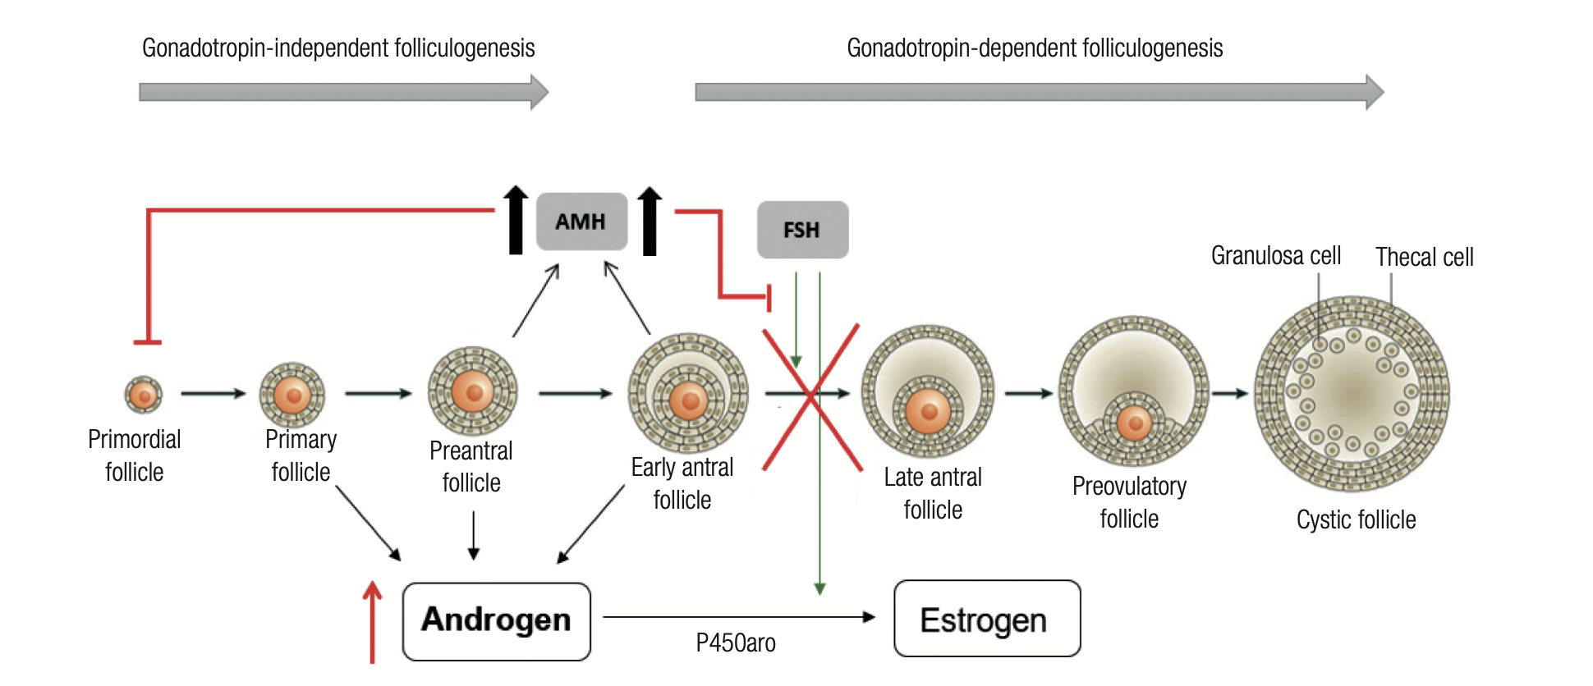
Instructions:
Polycystic Ovarian Syndrome
AMH is a modulator of folliculogenesis is a member of the GFR-beta superfamily that is produced by the granulosa cells
of small growing follicles.
Role of AMH in folliculogenesis. AMH has an inhibitory effect on the initial recruitment of primary follicles, on FSH-dependent follicular maturation and selection of dominant follicle, and on FSH-induced aromatase expression on granulosa cells, reducing the conversion of testosterone into estradiol. Higher AMH levels in PCOS patients turn the follicles more resistant to FSH action, culminating in inhibition of follicular maturation and ovulation and in inhibition of aromatase expression, consequently, leading to hyperandrogenism. Adapted from Azziz and cols. 2016 (1).
12
(Crespo et al., 2018)

Slide 13
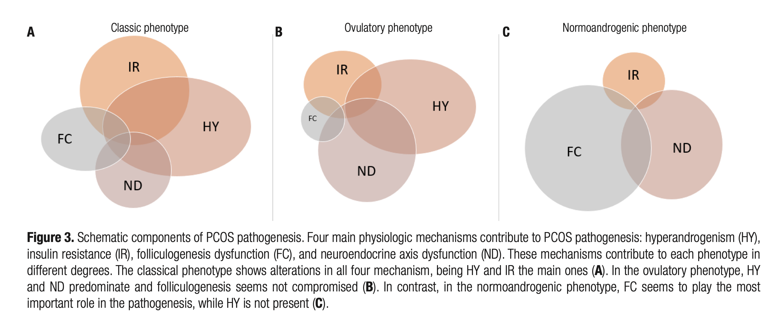
Instructions:
Polycystic Ovarian Syndrome- Obesity in Female and Male
Hyperandrogenism→ Female→ PCOS→Obesity
Hypoandrogenism→Male→(testosterone/Estrogen)→Obesity
Common denominator Insulin Resistance?
13
(Crespo et al., 2018)

Slide 14
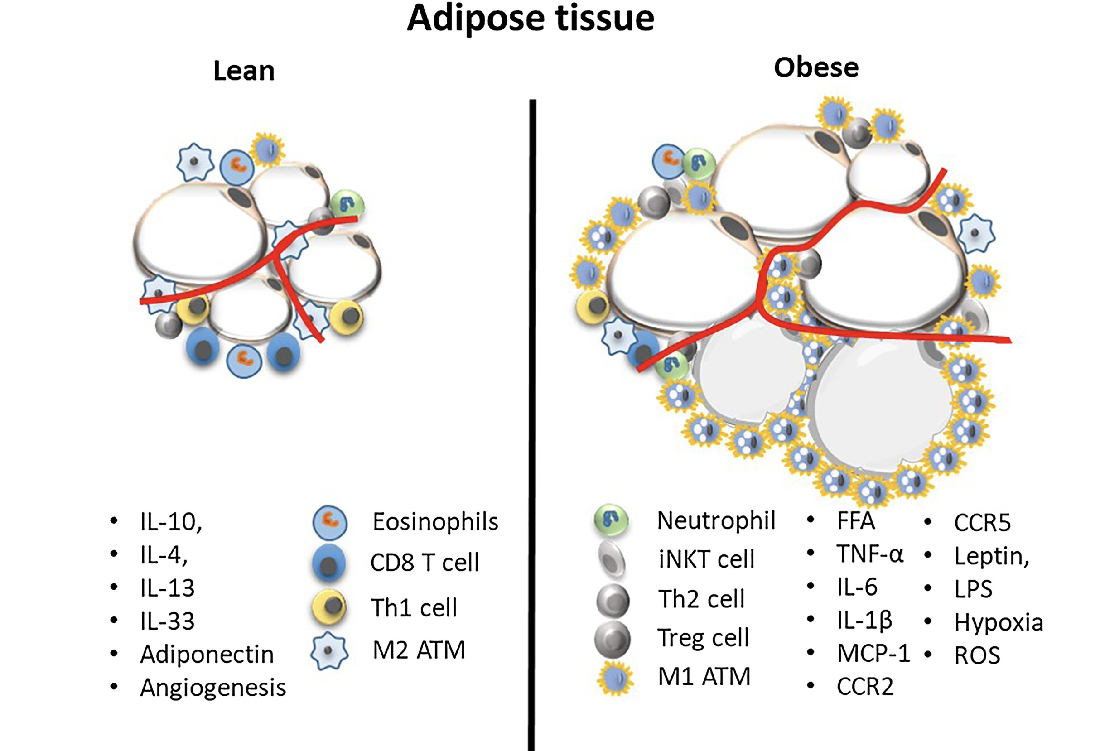
Instructions:
Insulin Resistance
Inflammatory states
FFA
Cytokines-regulators
14
(Ahmed et al., 2021)

Slide 15
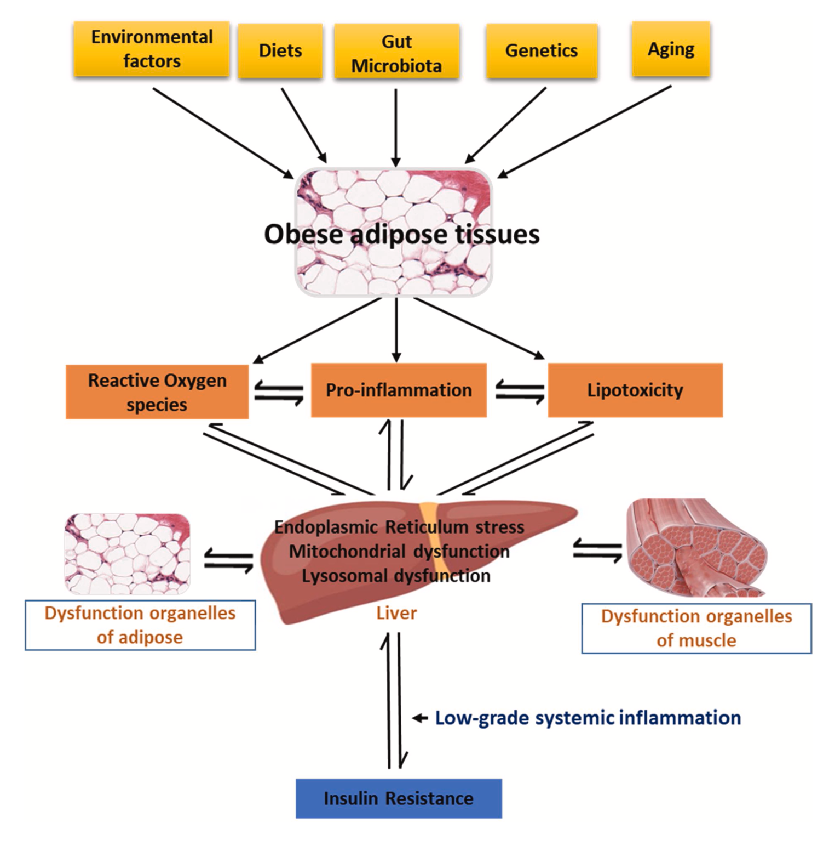
Instructions:
Insulin Resistance
Environmental
Diet
Gut
Genetics (obese gene or metabolic changes)
Aging
Multivariable → inflammatory cells
15
(Ahmed et al., 2021)

Slide 16
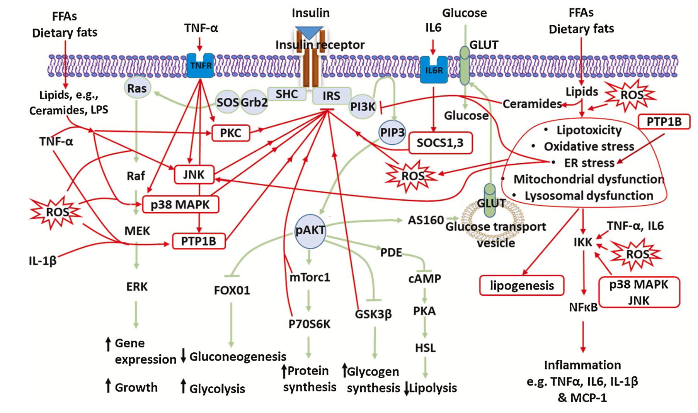
Instructions:
Insulin Resistance-Inflammation
16
(Ahmed et al., 2021)

Slide 17
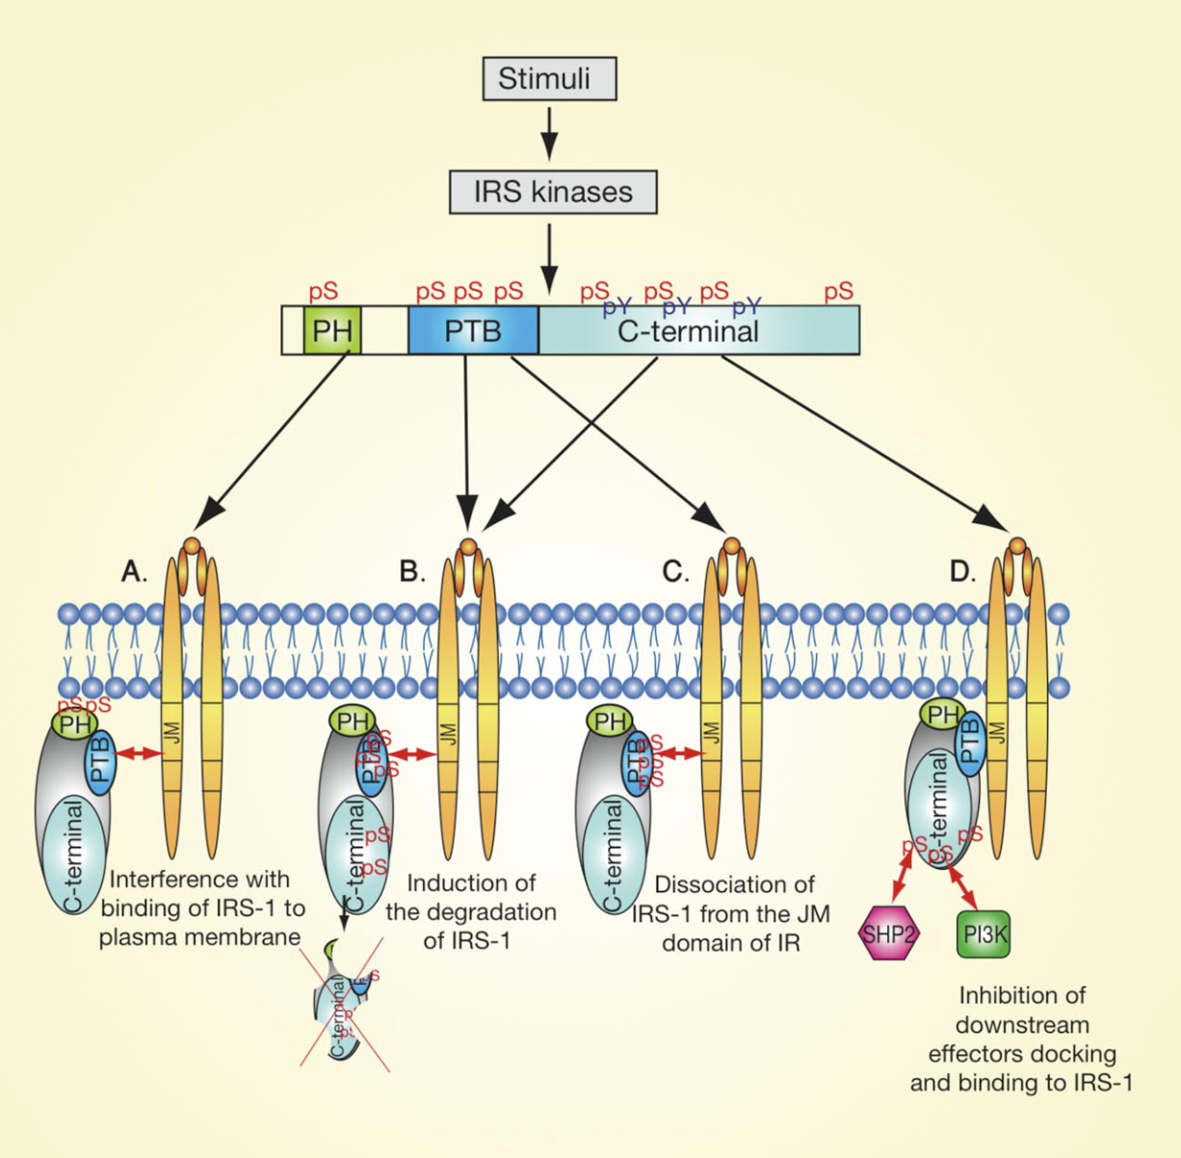
Instructions:
Insulin Resistance
Ser/Thr phosphorylation of IRS proteins
IRS-1, IRS-2
Inflammatory conditions result in increased activation of the kinases →
IRS-1/2 Phosphorylation
Role of Metformin?
17
(Boura-Halfon & Zick, 2009)

Slide 18
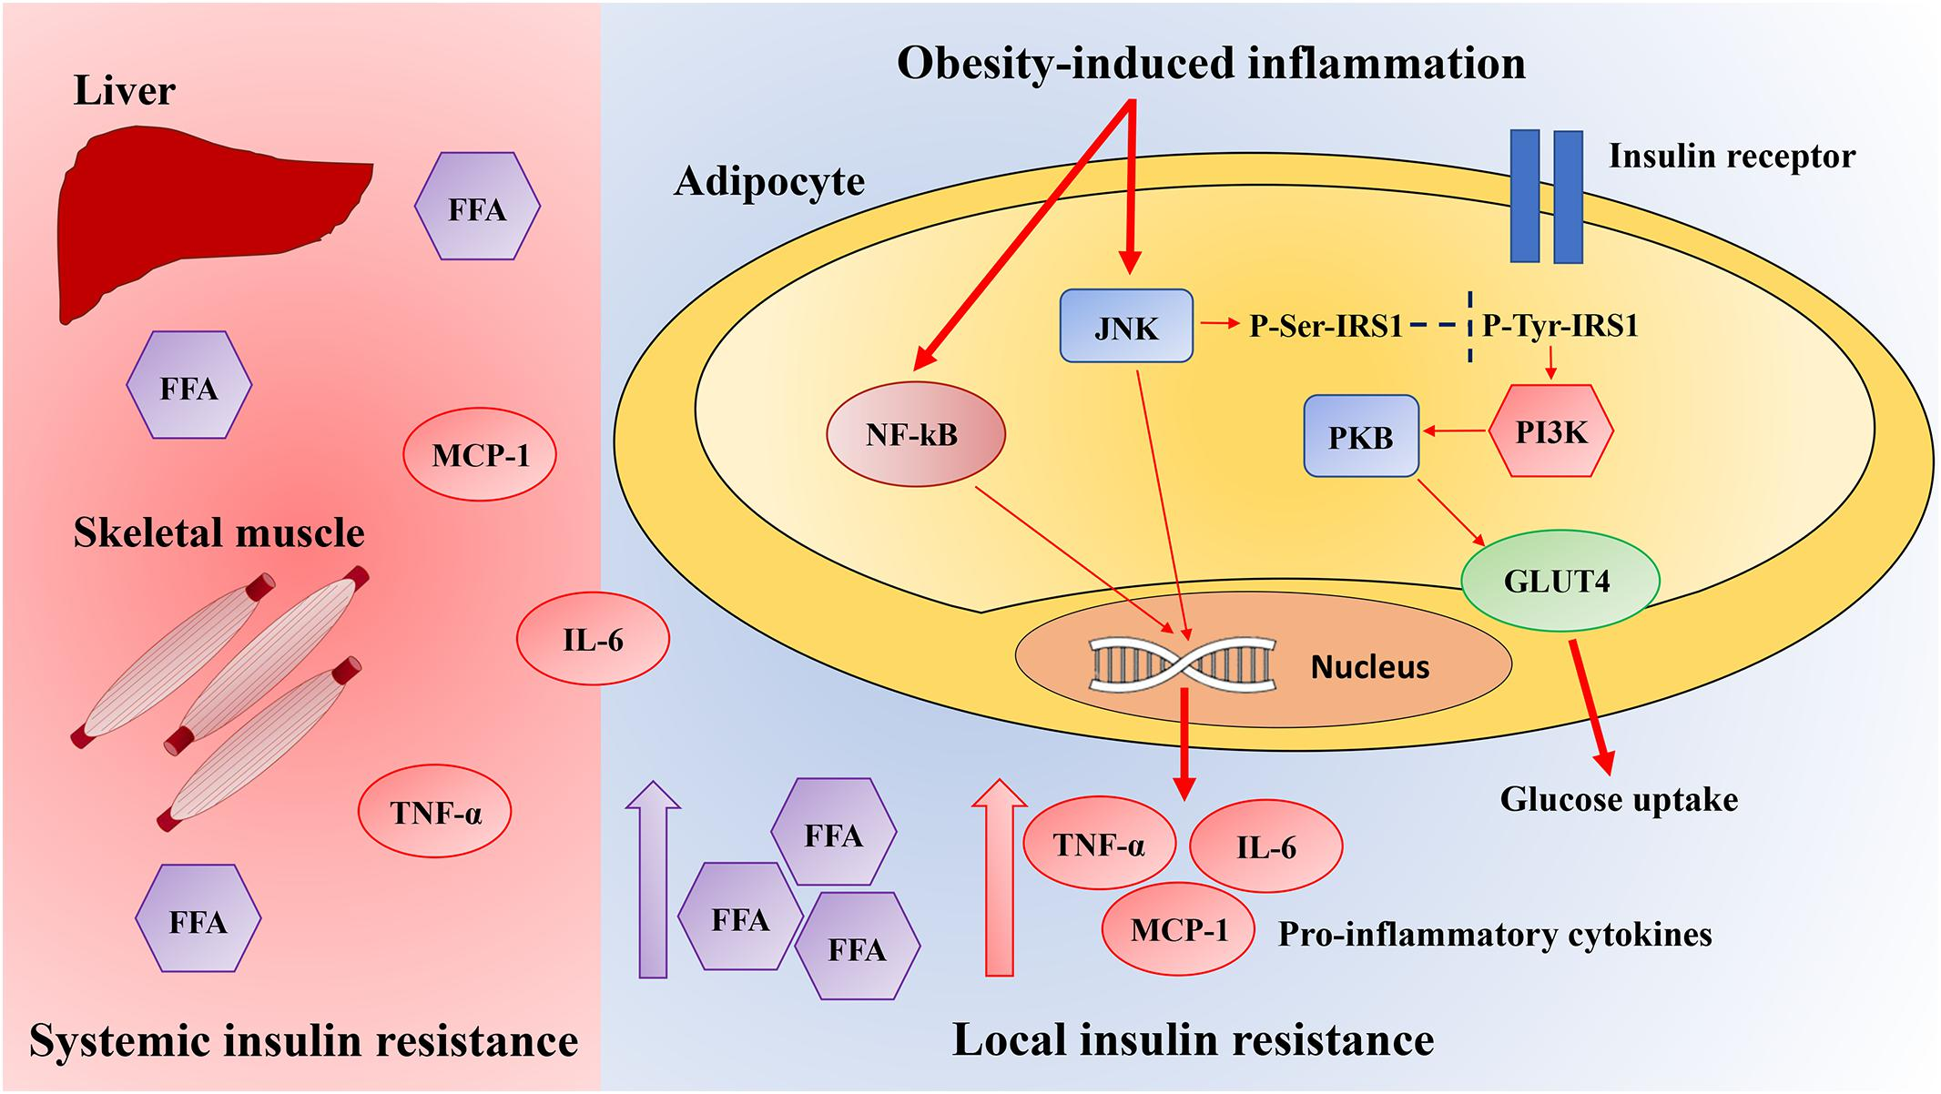
ns:
Insulin Resistance
Inflammatory cells involved systemically and locally
High fat diet → oxidative process
IR → IR1/2 phosorylation
(Rivellese et al., 2020 )
18

Slide 19
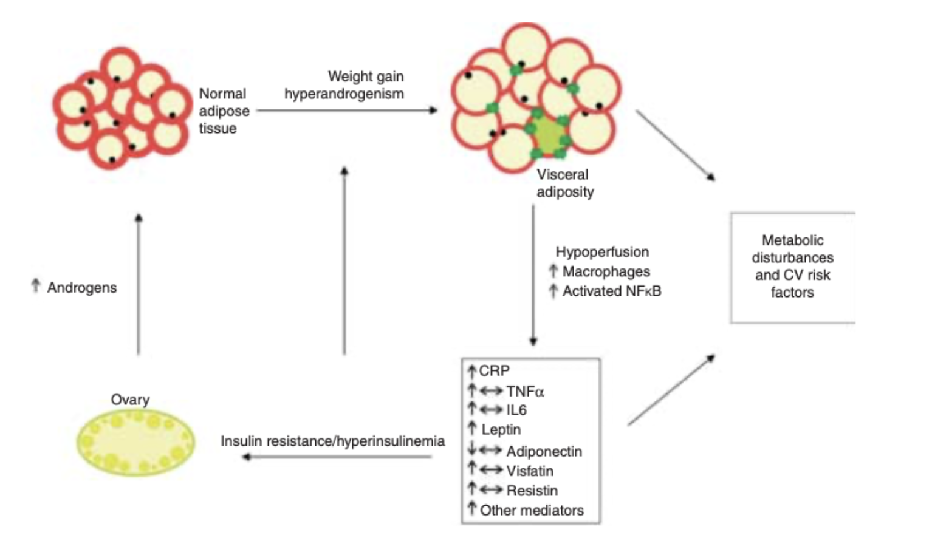
ns:
What is the theme ? Confused?
The expression and secretion of a wide variety of adipokines implicated in insulin resistance, including adiponectin and others, are also altered in PCOS.
(Spritzer et al., 2015)
19

Slide 20
ns:
What is the punch line?
Insulin Resistance
Oxidation
Fat metabolism dysfunction
PCOS (♀)
Weight gain
20
(Barber & Franks, 2021)
(Spritzer et al., 2015)

Slide 21
ns:
One thing to remember
Aging
Inactivity
Obesity
INSULIN
RESISTANCE
PCOS
NASH
Hypertension
Atherosclerosis
21

Slide 22
ns:
Summary
”As the obesity epidemic ensues, and the global population continues to rise, it is likely that the prevalence of PCOS will also increase.”
Treatment of IR and PCOS is initiated and includes weight loss (not by telling the patient to eat salads and exercise) -Behavior changes, lifestyle ( sleep, smoking, stress), and surgery.
The highest risk factor group is the adolescent female. Early intervention is critical to avoid the long term sequela of the IR.
22
(Barber & Franks, 2021; Jebeile et al., 2022)

Slide 23
Thank You!
https://www.dssurgery.com/lecture/

