Slide 1
Nutrition, Physiology of Malabsorption:
Hormonal Aspect
Pre-Operative Assessment
Ara Keshishian, M.D., FACS, FASMBS
Central Valley Bariatrics
Glendale, California

Slide 2
Disclaimer
No Conflict of Interest to Report
www.dssurgery.com

Slide 3
Outline
Pre-Operative Assessment -
Basic Evaluation
Specific to operation and /or condition
Duodenal Switch or Sleeve Gastrectomy
Primary DS or Revision-Conversion to DS
AGB, RNY, VBG, ERNY, SG
Pre-existing conditions - Reflux, Irritable bowel, pre-Transplant, Hx. CA, Steroids, Immune modulators
Dictates choice of the operation
Few words on GI - Hormones
www.dssurgery.com

Slide 4
Pre operative Work up
Assessment include - NIH
Most part of our practice of WLS
Medical Work up and clearances as needed
Nutrition, Metabolic
Hormonal - Pre-existing Conditions (hypothyroidism)
Vitamin, minerals, trace elements
Psychological evaluation
Nutritional evaluation
www.dssurgery.com

Slide 5
Detailed Exam
Questions
Sleep Apnea, Snoring, Activity tolerance
Knees and back or SOB
Night Blindness - Getting glasses
Physical Findings
Acanthosis Nigricans
Thyroid enlargements
Poor teeth
www.dssurgery.com

Slide 6
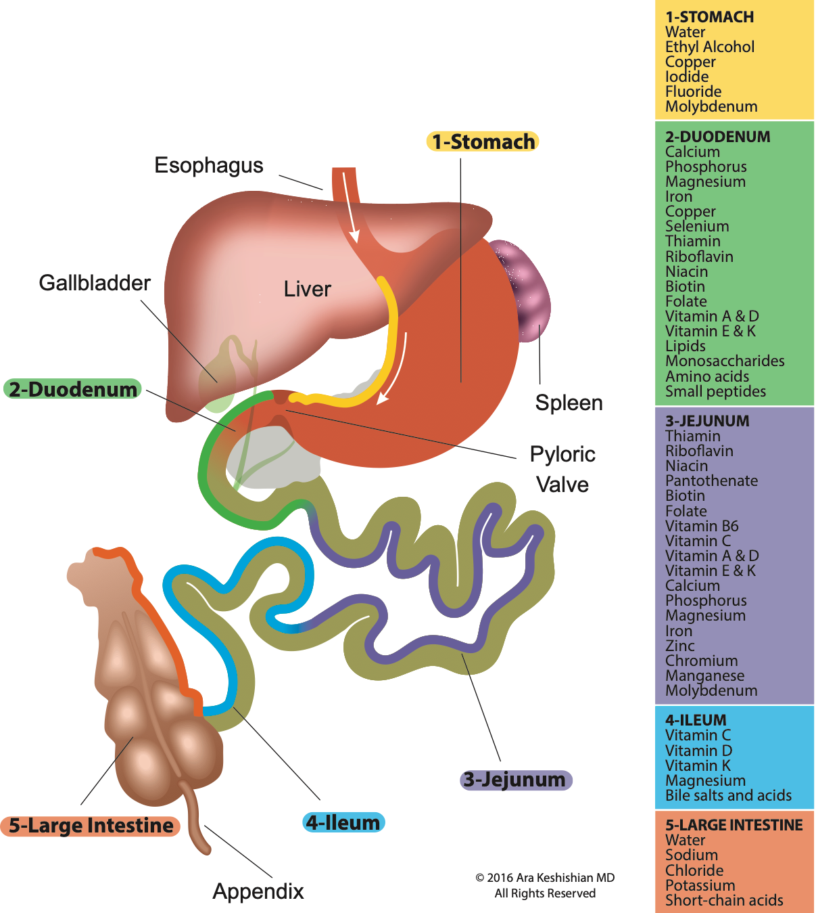
Absorption
Pre-operative work up
Educating the patient on
Absorption of
Normal anatomy
Surgical Options
Pre operative assessments of their understanding

Slide 7
Duodenal Switch
Sleeve Gastrectomy
Duodenoileostomy (~5 cm duodenum)
Jejunoileostomy
Percentage based
Measure SB
10% common Channel
40% Alimentary limb
Educate the patient
Data accurate

Slide 8
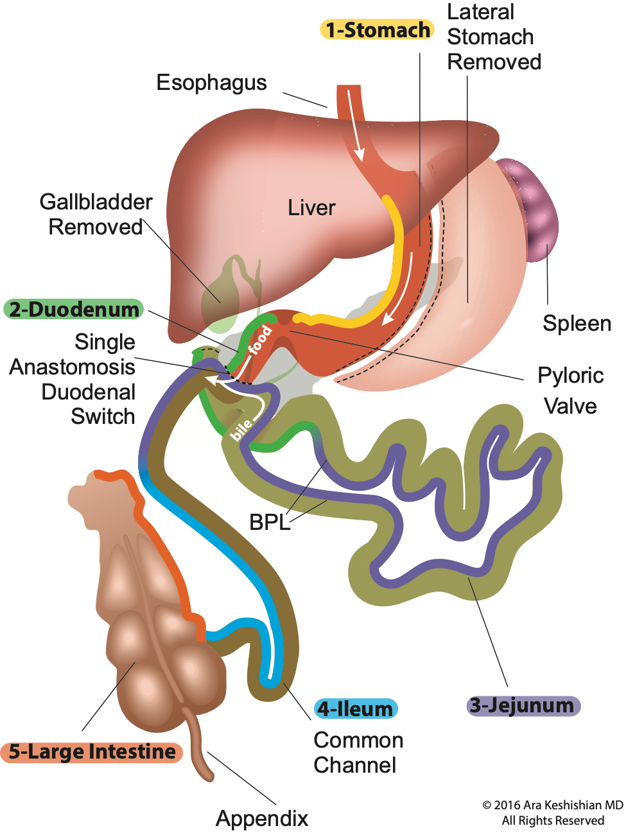
SIPS-SADI
Studying the data- long term
Barrier to delivery
Consent Issues
Hospital Privileges
Mal Practice coverage (Hospital and physician)
Reimbursement issues

Slide 9
”Work Up”
Complete Labs, Radiologic studies, Cardiac and Pulmonary testing
Revision, UGI, Endoscopy (GI)
Other screening as indicated (mammogram, colonoscopy, bone scan)
Labs:
CBC, CMP, LFT, Thyroid function, lipid panel
Vitamins: A, B6, B12, D-25OH
Iron studies, Zinc, Copper
CA, Mg, PTH
Nutrition: Total protein, Albumin, pre albumin
Urine Analysis
(special handling)
www.dssurgery.com

Slide 10
”Work Up” - Looking For
Cardiac Function (EF)
Sleep apnea - Reserve
UGI, Endoscopy (GI)
Hiatal Hernia Ulcer (s), H pylori, Bile reflux gastritis , esophagitis, Fistula, stricture, anatomy for revision, “Alternate facts” of the reports (note)
Labs:
Anemia, Electrolytes (meds), Steatohepatitis (pre operative weight loss- ? role)
Vitamin D deficiency (preexisting) elevated PTH, Role of Injection
Borderline protein levels poor diet
Calcium Oxalate crystals (ice tea, big gulp)
www.dssurgery.com

Slide 11
Subclinical Hypothyroidism
Typical patient - Female, Revision, unexplained sudden weight gain after years of stable weight
Endocrine - Hormones
Hypothyroidism, Dry skin, weight gain, constipation, bradycardia, depression, menorrhagia, heat intolerance
Autoimmune, iodine def, treated goiter, etc.
Normal (borderline labs)
Nothing new- 1980’s different opinions
www.dssurgery.com

Slide 12
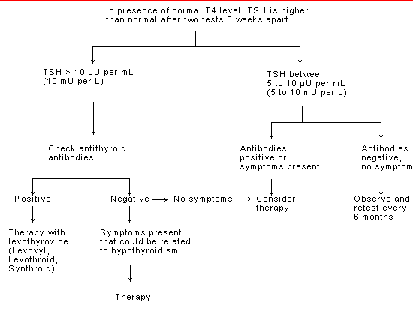
Subclinical Hypothyroidism
Subclinical Hypothyroidism: Deciding When to Treat Adlin MD et.al , Temple University School of Medicine, Philadelphia, Pennsylvania Am Fam Physician. 1998 Feb 15;57(4):776-780.
www.dssurgery.com

Slide 13
Subclinical Hypothyroidism
Noted in some revision patient
Lipid Panel - TG, TC, LDL elevated.
Observation
Cardiac Function measured as a component of ejection fraction pre ejection period (PEP) / (Left Ventricular Ejection Time) LVET improves with treatment
Rx - Levothyroxine 1.6 µg/Kg/day
25-50 µ g/day
www.dssurgery.com

Slide 14
“Clearances”
Medical Clearances
Cardiac and Pulmonary workup
OB - Evaluation (rec. against Depo / hor. implants)
Endocrinologist
Nutritional Evaluation
Educate not Test
Psychological Evaluation
Identify not Deny
Third party and Regulatory Guidelines
Objective :
Committed Informed patient
www.dssurgery.com

Slide 15
Committed Informed Patient
Duodenal Switch operation
Forgiving with diet and lifestyle for the most part
Not as much with non compliance of supplements
Alcohol, Drugs
www.dssurgery.com

Slide 16
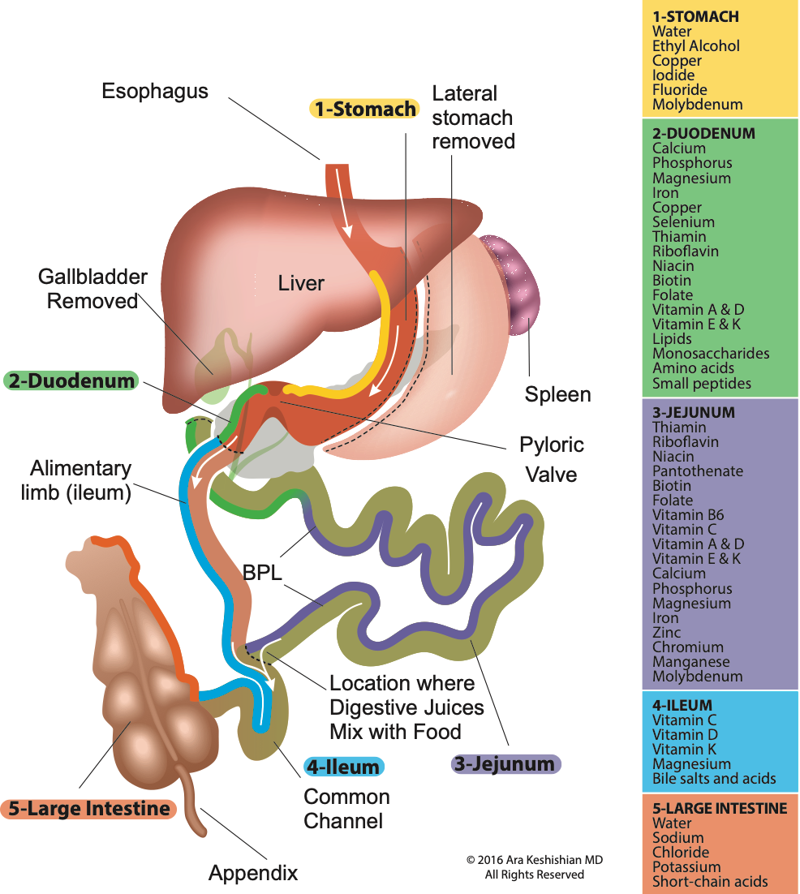
Malabsorption
www.dssurgery.com

Slide 17
GI Hormones
Hormone | Site of production | Stimulus for secretion | Likely actions
Gastrin | G cells in the gastric antrum and duodenum | Gastric distension & food in the stomach | •Increases production of hydrochloric acid, pepsinogen, intrinsic facto, pancreatic secretions and bile.•Promotes satiety
Ghrelin | Predominantly stomach and pancreas. | Empty stomach | •Stimulates appetite, increases hunger•Increases gastric emptying and gastrointestinal motility in preparation for eating•Induces growth hormone release•Inhibits glucose-stimulated insulin production
Cholecystokinin (CCK) | I cells in duodenal mucosa | Fatty acids or amino acids in the duodenum | •Contraction of the gallbladder releasing bile•Pancreatic enzyme secretion•Secretion of insulin, glucagon and PP•Slows gastric emptying•Promotes satiety
Secretin | S cells in duodenal mucosa | Low pH in the lumen | •Increases production of pancreatic bicarbonate•Reduces gastric acid production and inhibits gastrin release•Promotes insulin release•Reduces gastric and duodenal motility
Vasoactive intestinal polypeptide (VIP) | Enteric nerves and parasympathetic efferent nerve fibres | Vagal stimulation | •Increases the secretion of water and electrolytes out of cells and into the gut lumen•Relaxation of smooth muscle in the vasculature, gut and genitourinary system.•Reduces gastric acid production•Promotes hormone release from the pancreas, gut and hypothalamus
Pancreatic polypeptide (PP) | Produced by PP cells in the pancreas | Meal, especially high protein content. | •Regulates production of both exocrine and endocrine pancreatic secretions•Associated with satiety.
Gastric inhibitory peptide (GIP) | K cells in the gastrointestinal mucosa (ileum) | Nutrients in the gut lumen | •Incretin hormone, promoting insulin production and release in the pancreas•Promotes satiety•Promotes a postprandial rise in glucagon•Prevents beta cell apoptosis•Promotes the conversion of glucose to fatty acids and their storage in adipose,by increasing the activity of lipoprotein lipase.
Glucagon-like peptide -1 (GLP-1) | L cells in the gastrointestinal mucosa (ileum) | Nutrients in the gut lumen | •Incretin hormone, promoting insulin production and release in the pancreas•Reduces gastric emptying and intestinal motility•Promotes satiety
Glucagon-like peptide -2 (GLP-2)(99) | L cells in the gastrointestinal mucosa (ileum) | Nutrients in the gut lumen | •Promotes gut hypertrophy•Possible role in glucose homeostasis•Possible role in slowing gut motility to promote absorption
Oxyntomodulin | L cells in the gastrointestinal mucosa (ileum) | Nutrients in the gut lumen | •Promotes satiety•Agonist of glucagon receptor and GLP-1 receptors•Increases energy expenditure
Peptide YY (PYY) | L cells in the gastrointestinal mucosa (colon) | Nutrients in the gut lumen | •Promotes satiety•Reduces gastric emptying and intestinal motility•Ileal brake
1- Claire L Meek et. al, Institute of Metabolic Science, Metabolic Research Laboratories, University of Cambridge Peptides, 77, 2016, 28-37
www.dssurgery.com

Slide 18
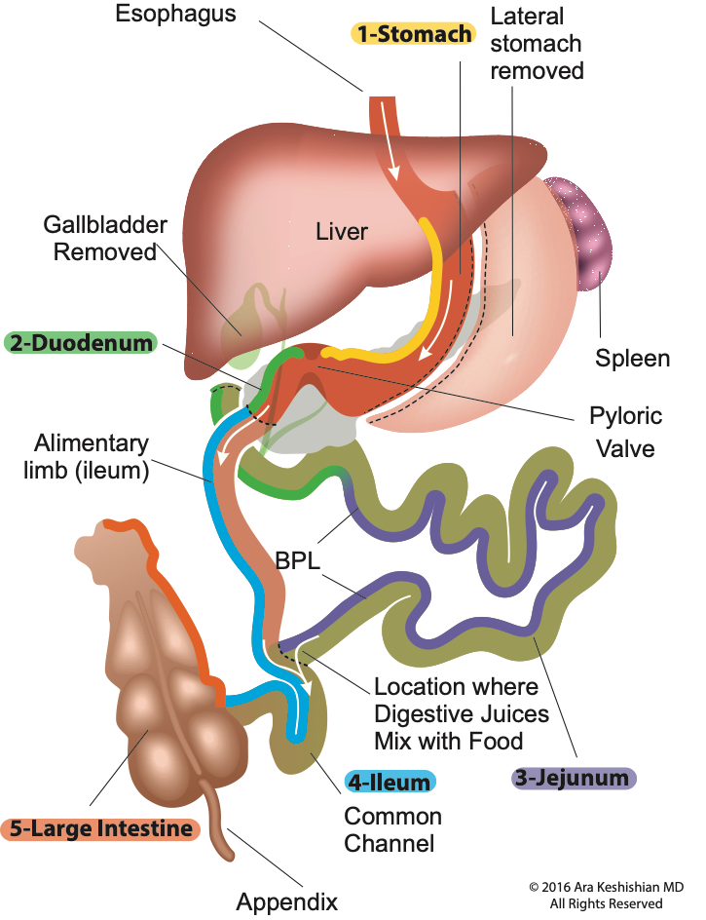
Malabsorption
Ghrelin Hunger and GH release
CCK GB contraction, GI motility, Pancreatic Exocrine secretion Secretin Pancreatic Exocrine secretion
Insulin & Glucagon Glucose homeostasis PP Gastric Motility
GLP-1: Satiety and motility GLP-2: GI motility and growth PYY : Satiety
GLP-1: Satiety and motility GLP-2: GI motility and growth PYY : Satiety
www.dssurgery.com

Slide 19
Summary
Pre operative evaluation
Mitigate
Risk of anesthesia - short term
Risk of peri-operative complications
Risk of post operative complications immediate and long term
www.dssurgery.com

Slide 20
Summary
Medical clearances
Labs
Radiologic studies
Endoscopy as indicated
www.dssurgery.com

Slide 21
Thank you
www.dssurgery.com

