Slide 1
Fatty Acid Metabolism in Humans
Ara Keshishian, MD, FACS, FASMBS
Yerevan, Armenia
November 2019

Slide 2
Overview
Adipose function in humans
Free fatty acids (FFA) and health
Regulation of FFA metabolism
FFA in different types of obesity

Slide 3
Fat and Lean Interactions
Lean Body Mass
Adipose
tissue
Notes:
An incompletely understood issue is how adipose tissue and lean tissue interact to produce the adverse metabolic consequences of obesity.

Slide 4
Body Fat in Humans
% body fat
Lean
men
Lean
women
Obese
men
Obese
women
Adapted from Nielsen S et al. J Clin Invest 2004; 113: 1582-8
Notes:
This shows the average percent body fat in normal weight men and women, as well as in men and women with a body mass index between 30 – 35 kg/m².

Slide 5
Regional Body Fat in Humans: Where Is It?
% of fat in region
Lean men
Lean women
SQ: subcutaneous
Adapted from Nielsen S et al. J Clin Invest 2004; 113: 1582-8
Notes:
This shows the average percent body fat in normal weight men and women, as well as in men and women with a body mass index between 30 – 35 kg/m².

Slide 6
Regional Body Fat in Humans: Where Is It?
% of fat in region
Obese men
Upper body obese women
Lower body obese women
SQ: subcutaneous
Adapted from Nielsen S et al. J Clin Invest 2004; 113: 1582-8
Notes:
This shows the average percent body fat in normal weight men and women, as well as in men and women with a body mass index between 30 – 35 kg/m².

Slide 7
Virtually all fatty acids originate from dietary triglyceride fatty acids.
Long-term storage site is adipose tissue.
Regulated release of fatty acids as free fatty acids provides the majority of lipid fuel for post-absorptive adults.

Slide 8
Fatty Acid Metabolism in Humans
Direct Oxidation
CO₂ + H₂O
(20-70 gm)
TG fatty acids
Oxidation 100 gm
Chylomicron TG 100 gm
FFA
FFA: free fatty acids
TG: triglycerides
Adipose tissue
(30-80 gm)
Notes:
This depicts the fate of fatty acids in the average diet of weight stable adults in most Western countries.

Slide 9
Adipose Physiology
Insulin
FFA
Triglycerides
Glycerol
Adipocyte
FFA: free fatty acids
Notes:
Under resting, postabsorptive conditions, free fatty acids and glycerol are released from adipocytes. With meal ingestion, insulin secretion increases substantially.

Slide 10
Adipose Physiology
Insulin
↓ FFA
Triglycerides
↓ Glycerol
Adipocyte
FFA: free fatty acids
Notes:
Under resting, postabsorptive conditions, free fatty acids and glycerol are released from adipocytes. With meal ingestion, insulin secretion increases substantially.

Slide 11
Adipose Physiology
Growth hormone
catecholamines
FFA
Triglycerides
Glycerol
Adipocyte
FFA: free fatty acids
Notes:
Under resting, postabsorptive conditions, free fatty acids and glycerol are released from adipocytes. With meal ingestion, insulin secretion increases substantially.

Slide 12
Adipose Physiology
Growth hormone
catecholamines
FFA
Triglycerides
Glycerol
Adipocyte
FFA: free fatty acids
Notes:
Under resting, postabsorptive conditions, free fatty acids and glycerol are released from adipocytes. With meal ingestion, insulin secretion increases substantially.

Slide 13
Fatty acids have four major physiological roles:
Building blocks of phospholipids and glycolipids.
Many proteins are modified by the covalent attachment of fatty acids, which target them to membrane locations
Fatty acids are fuel molecules. Stored as TG. FA mobilized from TG are oxidized to meet the energy needs of a cell or organism.
FA derivatives serve as hormones and intracellular messengers e.g. steroids, sex hormones and prostaglandins.

Slide 14
Resting Energy Expenditure vs. Free Fatty Acid Flux
Women
Men
Palmitate release (μmol/min)
kcal/day
Adapted from Nielsen S et al. J Clin Invest 2003; 111: 981-8
Notes:
This shows the relationship between basal metabolic rate (kcal/day) and palmitate (one of the major free fatty acids) release in men and women. Women have 40% greater free fatty acid release than men at the same metabolic rate, the same fat oxidation rates, and the same FFA concentrations.

Slide 15
Intra-abdominal (Visceral) Fat Area vs. Residual Palmitate Flux
Men
Women
50
Residual palmit
50
(μmol/min)
0
0
Residual palmitate release
0
300
0
300
(umol/min)
r=0.45
p<0.05
-50
Release
-50
Intra-abdominal fat area (cm²)
Intra-abdominal fat area (cm²)
Adapted from Nielsen S et al. J Clin Invest 2003; 111: 981-8
Notes:
This shows the relationship between intra-abdominal (visceral) fat area as measured by single slice computed tomography and the residual variance in palmitate release relative to REE in men and women. Visceral fat correlated with the residual variance in free fatty release release in men. Not shown: plasma epinephrine concentrations also were correlated with the residual variance in FFA release.

Slide 16
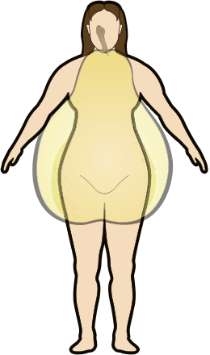
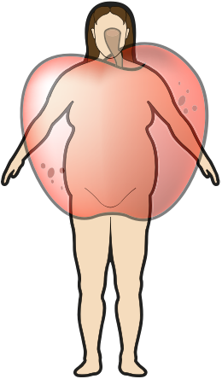
Body Fat Distribution and Free Fatty Acids (FFA)
Normal FFA
High FFA
Notes:
Women with lower body obesity tend to have normal free fatty acid metabolism whereas women with upper body obesity have high free fatty acid concentrations and release under most circumstances.

Slide 17
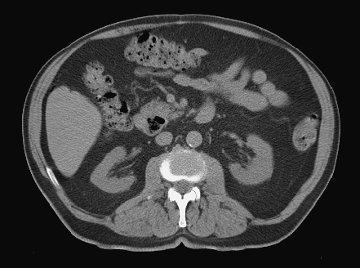
Intra-abdominal (Visceral) Fat and Upper Body Obesity
Intra-abdominal fat
Subcutaneous fat
Notes:
Is visceral fat the source of excess free fatty acids in upper body obesity?

Slide 18
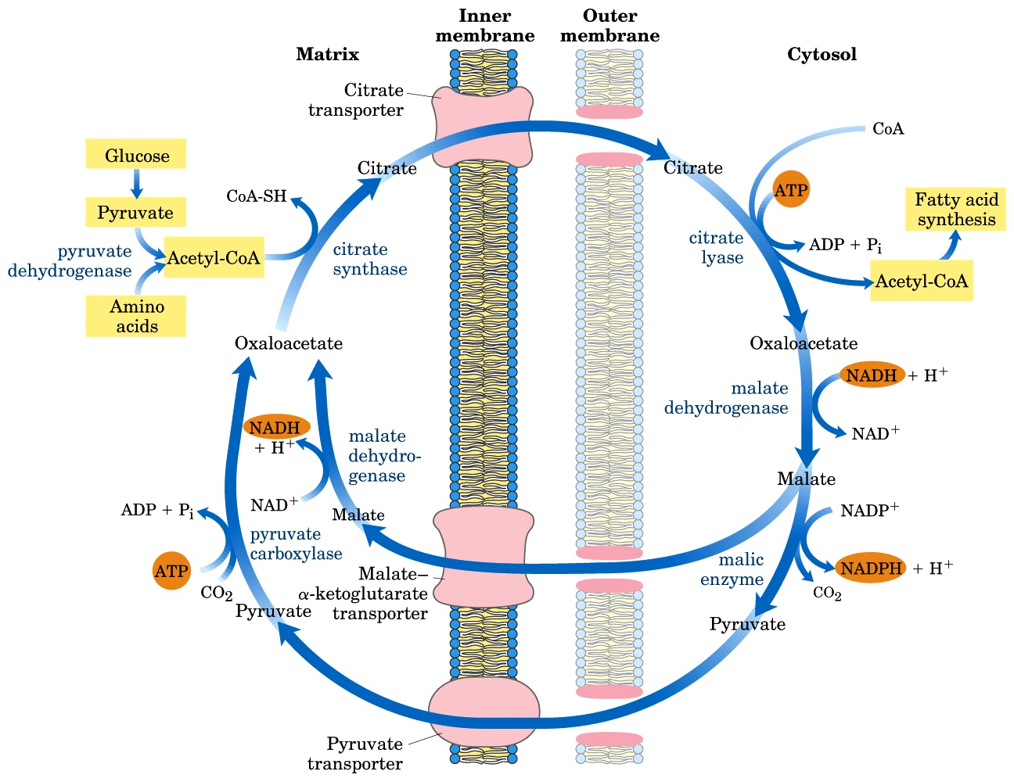
Kreb Cycle
Notes:
Is visceral fat the source of excess free fatty acids in upper body obesity?

Slide 19
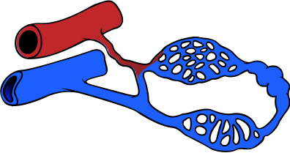
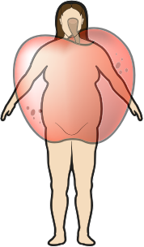
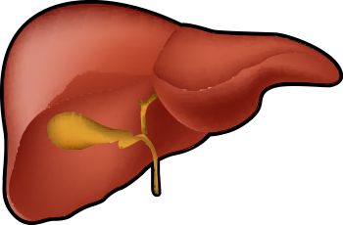
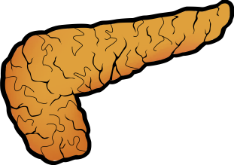
Upper Body / Intra-abdominal (Visceral) Obesity and Insulin Resistance
Upper body /
Intra-abdominal obesity
Muscle
Vasculature
Insulin resistance
Constriction ↓ Relaxation
Insulin resistance
FFA
Liver
Pancreas
Glucose
release
Insulin
secretion
Notes:
Artificial elevation of free fatty acids in lean humans can cause muscle insulin resistance, endothelial dysregulation, abnormal insulin secretion, and impair insulin’s ability to suppress hepatic glucose release. Thus, the high free fatty acids in upper body obesity may play an important role in the adverse metabolic consequences of obesity.

Slide 20
Regional Adipose Tissue Model
Upper body subcutaneous fat
Intra-abdominal (visceral) fat
Lower body subcutaneous fat
Notes:
We measured regional free fatty acid uptake and release using isotope dilution and regional blood flow techniques in persons with catheters placed in the femoral artery, femoral vein, and hepatic veins to collect blood samples.

Slide 21
Splanchnic Contribution to Basal Upper Body Adipose Tissue Free Fatty Acid Release
*
μmol/min
Lower body obese women
Upper body obese women
Lean women
Adapted from Martin ML and Jensen M. J Clin Invest 1991; 88: 609-13
Notes:
The excess free fatty acid release in upper body obese women compared with lower body obese women originates from upper body subcutaneous, not visceral, fat under postabsorptive conditions.

Slide 22
Regional Free Fatty Acid Release During Meal Ingestion
*
μmol/min
*
*
*
Nonsplanchnic
upper body
Splanchnic
Leg
Nonsplanchnic
upper body
Splanchnic
Leg
Upper body obese
Lower body obese
* p<0.05 vs. basal values
Adapted from Guo Z et al. Diabetes 1999; 48: 1586-93
Notes:
Under postprandial conditions, the excess free fatty acid release in upper body obesity compared with lower body obesity also originates from upper body subcutaneous fat, not visceral or leg fat.

Slide 23
Regional Free Fatty Acid Release in Obese Nondiabetics and Obese Type 2 Diabetics
Percent of total
Nondiabetic
Diabetic
Adapted from Basu A et al. Am J Physiol 2001; 280: E1000-6
Notes:
Under insulin-suppressed conditions, the relative contribution of visceral (splanchnic) free fatty acid release is not different in viscerally obese type 2 diabetics compared with non-diabetic obese control subjects.

Slide 24
Hepatic Free Fatty Acid (FFA) Delivery
Women
Men
% Hepatic FFA delivery
from intra-abdominal fat
Intra-abdominal (visceral) fat area (cm²)
Adapted from Nielsen S et al. J Clin Invest 2004; 113: 1582-8
Notes:
A novel model of portal free fatty acid delivery to liver was used to determine the relationship between visceral fat and the proportion of hepatic free fatty acid delivery from visceral lipolysis. Although persons with greater amounts of visceral fat do have slightly greater portions of hepatic free fatty acid delivery from omental and mesenteric adipose tissue free fatty acid release, the majority of hepatic free fatty acid delivery was found to come from the systemic circulation.

Slide 25
Free Fatty Acids (FFA) and Pancreas
Insulin resistance
FFA
Pancreas
Adipose tissue
Short-term stimulation of insulin secretion
Long-term damage to
beta cells
Decreased insulin
secretion
Notes:
The higher free fatty acid concentrations in upper body obesity that can affect pancreatic function are from systemic FFA, and thus largely originate from upper body subcutaneous fat.

Slide 26
Free Fatty Acids (FFA) and Dyslipidemia
Insulin resistance
FFA
Liver
Adipose tissue
Apo B100 synthesis and secretion
VLDL-TG
TG: triglycerides
↓ HDL cholesterol
Notes:
The higher free fatty acid concentrations in upper body obesity that can affect pancreatic function are from systemic FFA, and thus largely originate from upper body subcutaneous fat.

Slide 27
Free Fatty Acids (FFA) and Glucose Production
Insulin resistance
FFA
Liver
Adipose tissue
Glucose release
Notes:
The higher free fatty acid concentrations in upper body obesity that can affect pancreatic function are from systemic FFA, and thus largely originate from upper body subcutaneous fat.

Slide 28
Free Fatty Acids (FFA) and Muscle
Insulin resistance
FFA
Insulin resistance
Muscle
Adipose tissue
Skeletal muscle cells
Intra-muscular TG
↓ Glucose uptake
TG: triglycerides
Notes:
The higher free fatty acid concentrations in upper body obesity that can affect pancreatic function are from systemic FFA, and thus largely originate from upper body subcutaneous fat.

Slide 29
Free Fatty Acids (FFA) and Hypertension
Insulin resistance
FFA
Vasculature
Constriction – greater response to alpha-adrenergic stimuli
Adipose tissue
↓ Relaxation – decreased nitric oxide generation
Notes:
The higher free fatty acid concentrations in upper body obesity that can affect pancreatic function are from systemic FFA, and thus largely originate from upper body subcutaneous fat.

Slide 30
Therapies that correct abnormal adipose tissue free fatty acid release may improve the metabolic abnormalities seen in upper body obesity even if weight loss is not successful.

Slide 31
Adipose Tissue as Endocrine Cells
Leptin
Adiponectin
Angiotensinogen
Tumor necrosis factor-α
Resistin
Retinol binding protein-4
Interleukin-6
Visfatin
Notes:
In addition to the free fatty acid release functions of adipose tissue, it has been shown to release a large number of “adipokines”. These range from typical inflammatory cytokines (tumor necrosis factor-α and interleukin-6) to insulin sensitizing molecules (adiponectin and visfatin) and molecules thought to induce insulin resistance (retinol binding protein-4).

Slide 32
Fat is a dynamic and varied tissue.
Regional differences in adipose biology affect health.
The causes of differences in body fat distribution are unknown.
The relative contributions of high free fatty acids and adipokines to adverse health is unknown.

Slide 33
Thank you

